Slide 1
DO NOW:
Pick up a text book.
Using pages 38 -39 make a quick list of the “Three Fundimental Economic Questions” that every society faces.

Slide 2
What goods and services are to be produced?
Millions of possible products can be produced, but with limited resources people must make choices

Slide 3
How are goods and services to be produced?
How should the Factors of Production (Land, Labor and Capital) be used together to produce a certain product?

Slide 4
For whom are goods and services to be produced?
Should goods and services be distributed dependent upon
Who can afford them?
What would be considered equal and fair?
On a first come/first served basis?

Slide 5
Market Economy - An economic system in which economic decisions are left up to individual producers and consumers

Slide 6
Market
A place where buyers and sellers come together to do business.
“Goods and Services Market”
Sells things and services that have been produced by “Firms”
Examples:
A store
The Stock Market
The Internet

Slide 10
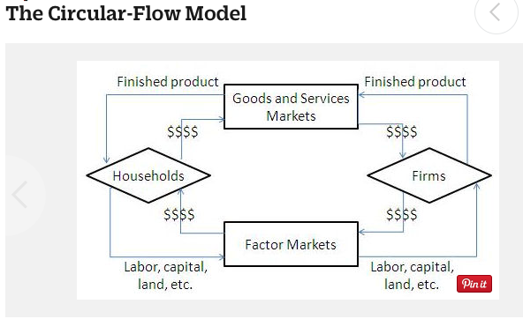

Slide 11
The Circular-Flow Model describes the flow of money and products throughout the economy in a very simplified way.

Slide 12
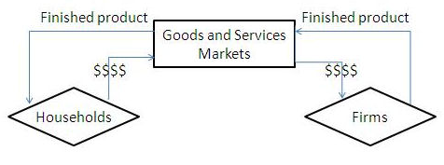
In goods and services markets, households (consumers like you and I) buy finished products from firms that are looking to sell what they make.

Slide 13
In goods and services markets, households (consumers like you and I) buy finished products from firms that are looking to sell what they make.

Slide 14
Money flows from households to firms, and this is represented by the direction of the arrows on the lines labeled “$$$$”

Slide 15
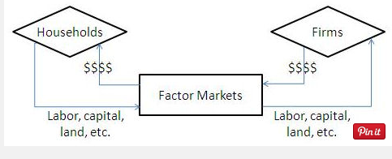
However, goods and services markets don’t tell the whole story. Factor Markets ( “factors of production”) serve to complete the circular flow of money and resources.
. Factor Markets ( “factors of production”) refer to anything that is used by a firm in order to make a final product. Some examples of factors of production are labor (the work done by people), capital (the machines used to makes products) and land (the natural resources used to make the products)

Slide 16
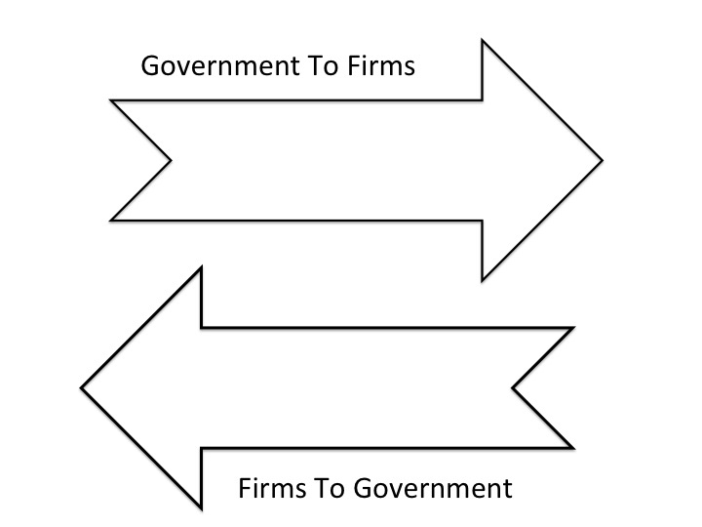
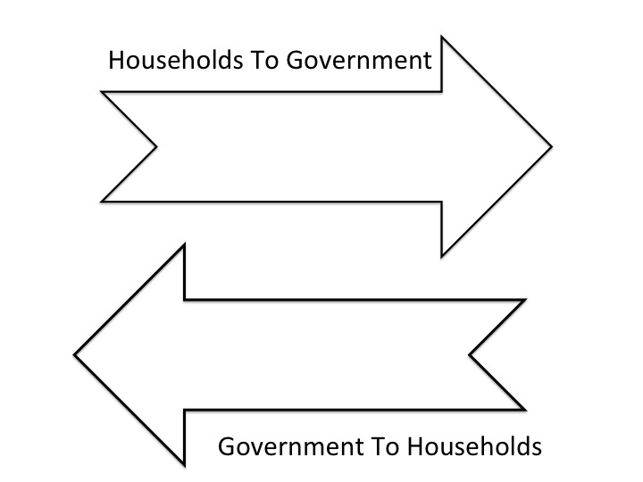
FROM: GOODS & SERVICES MARKET TO:FIRMS
FROM: HOUSEHOLDS
TO: GOODS AD SERVICES
GOODS & SERVICES MARKET
FROM: FIRMS
TO: HOUSEHOLDS
FROM: GOODS AD SERVICES MARKET
TO: HOUSEHOLDS
GOVERNMENT
HOUSEHOLDS
FIRMS
FROM: HOUSEHOLDS
TO FACTORS OF PRODUCTION MARKET
:
FROM: FACTORS OF
PRODUCTION MARKET
TO :FIRMS
FACTORS OF
PRODUCTION MARKET
FROM: FIRMS
TO:FACTORS OF PRODUCTION MARKET
FROM: FACTORS OF PRODUCTION MARKET
TO: HOUSEHOLDS

Slide 17
GOVERNMENT

